Slide 1
Our house
07. Quantifiers, similarities and differences

Slide 2
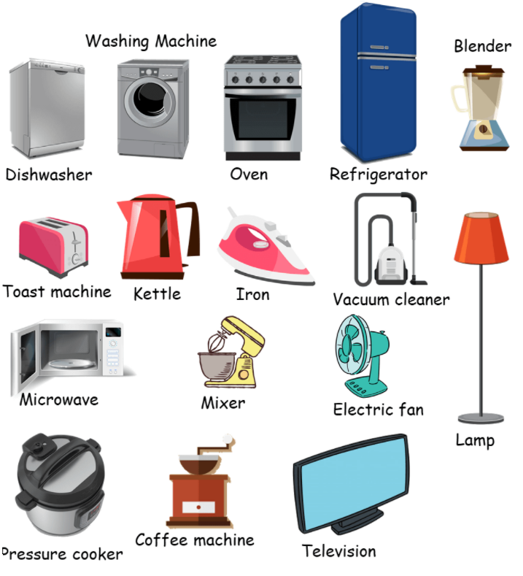
Our house
Do you live in a house or an apartment?
What appliances do you have in your house?
Tenant: person wishing to rent
Landlord: person who owns and rents the property
Price range: the amount you can pay
Roommate: person who rents with you
Make an offer: inform the landlord you want to rent the property

Slide 3
Too / Enough
We use too + adjective to say there is more of a certain quality than is needed.
This apartment is too big for two people.
We use adjective + enough to say there is a sufficient amount of a certain quality.
The closet is large enough for all my clothes.
We use not + adjective + enough to say there is an insufficient amount of a certain quality.
The wallpaper is not pretty enough for me

Slide 4
Choose too or enough
I left the coffee for a minute to cool because it was ____ hot to drink.
He wasn’t strong ____ to lift that heavy box.
There aren’t ____ police officers in our town.
Do you have ____ information to help me with this problem?
It is ____ difficult to rent in the city without a reference.
I do not have ____ much time to arrange a viewing.
Unfortunately, I didn’t have ____ money to make an offer.
You are ____ irresponsible to have a good credit score.
We are neighbors. We live close ____ to each other.
The landlord is ___ negligent. He does not want to fix anything.
Notes:
I left the coffee for a minute to cool because it was too hot to drink.
He wasn’t strong enough to lift that heavy box.
There aren’t enough police officers in our town.
Do you have enough information to help me with this problem?
It is too difficult to rent in the city without a reference.
I do not have enough much time to arrange a viewing.
Unfortunately, I didn’t have enough money to make an offer.
You are too irresponsible to have a good credit score.
We are neighbors. We live close enough to each other.
The landlord is too negligent. He does not want to fix anything.

Slide 5
Quantifiers: Many, Much, A lot of / Lots of
We use many with countable nouns.
There are many built-in closets in my new apartment.
We use much with uncountable nouns. We usually use much in negative sentences.
I don’t have much time to move in.
We can use a lot of or lots of with either countable or uncountable nouns.
There are a lot of built-in closets in my new apartment.
I have lots of time to move in to my new apartment. (less formal)
Note: We often use a lot of or lots of in positive sentences instead of many or much in less formal conversations
Notes:
Exercise
https://test-english.com/grammar-points/a2/too-too-much-too-many-enough/

Slide 6
Much, many / a lot of, lots of?
We have much/many pieces of furniture.
How much/many is the deposit? One month of rent.
How much/many families live in the building?
My landlord has much/a lot of tenants.
I viewed much/lots of properties before I rented my apartment.
His real estate agent had many/a lot of work. She was always on the phone.
Were there much/a lot of houses for sale?
Many/Much tenants aren’t careful with the properties.
Much/Many neighborhoods are being gentrified by foreigners.
It takes much/many effort to find an affordable home nowadays.
Notes:
We have many pieces of furniture.
How much is the deposit? One month of rent.
How many families live in the building?
My landlord has a lot of tenants.
I viewed lots of properties before I rented my apartment.
His real estate agent had a lot of work. She was always on the phone.
Were there a lot of houses for sale?
Many tenants aren’t careful with the properties.
Many neighborhoods are being gentrified by foreigners.
It takes much effort to find an affordable home nowadays.
Arrendatario: tenant
Arrendador: landlord

Slide 7
Fewer, Less
Fewer is the comparative form of the adjective few. We use fewer with countable nouns.
My new apartment has fewer closets than my old apartment.
Less is the comparative form of the adjective little. We use less with uncountable nouns.
There is less space in my new apartment than in my old apartment.
Notes:
Review of quantifiers
https://www.youtube.com/watch?v=tBPHmLuYSqU&t=143s

Slide 8
Fewer or less?
The water pressure here is ____ potent than in the other house.
There are ____ cars on the roads in this part of town.
The landlord asked the tenant to make ____ noise than the neighbors.
This house has ____ problems than the last ones we have viewed.
They have ____ patience than the previous tenants.
The agent had ____ time to prepare the house for the viewing.
Our bank gave us ____ days to send the paperwork.
The mortgage process had ____ paperwork the second time we did it.
The kitchen cabinets have _____ room than I thought.
____ homes are built by individuals than the private sector.
Notes:
The water pressure here is less potent tan in the other house.
There are fewer cars on the roads in this part of town.
The landlord asked the tenant to make less noise than the neighbors.
This house has fewer problems than the last ones we have viewed.
They have less patience than the previous tenants.
The agent had less time to prepare the house for the viewing.
Our bank gave us a fewer days to send the paperwork.
The mortgage process had less paperwork the second time we did it.
The kitchen cabinets have less room than I thought.
Fewer homes are build by individuals than the private sector.

Slide 9

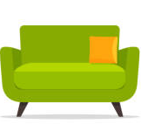
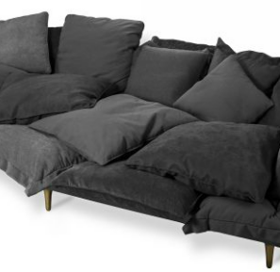
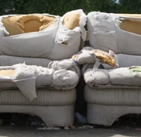
(not) as + adjective + as
We use as + adjective + as when we want to show that two things are equal.
This couch is as good as the other one.
We use not as + adjective + as when we want to show that two things are not equal.
This couch is not as good as the other one.

Slide 10
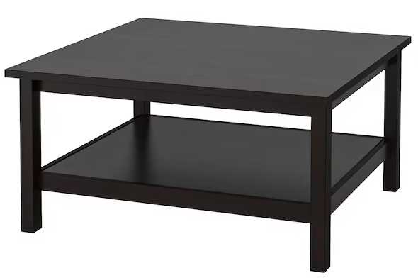
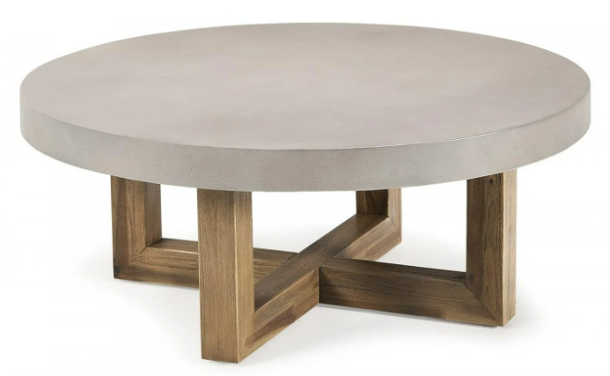
(not) the same as
We also use the same as to show that two things are identical.
Our new coffee table is the same as our old coffee table.
We use not the same as to show that two things are not identical.
Our new coffee table is not the same as our old coffee table.

Slide 11




similar to / like / different from
We use similar to and like to show that two things share some quality or characteristic, but are not necessarily identical.
This couch is similar to the other one. (The color is the same, but the style is different.)
This couch is like the other one. (The color is the same, but the style is different.)
We use different from and not like to show that two things are different.
Our new couch is different from our old couch.
Our new couch is not like our old couch.

Slide 12
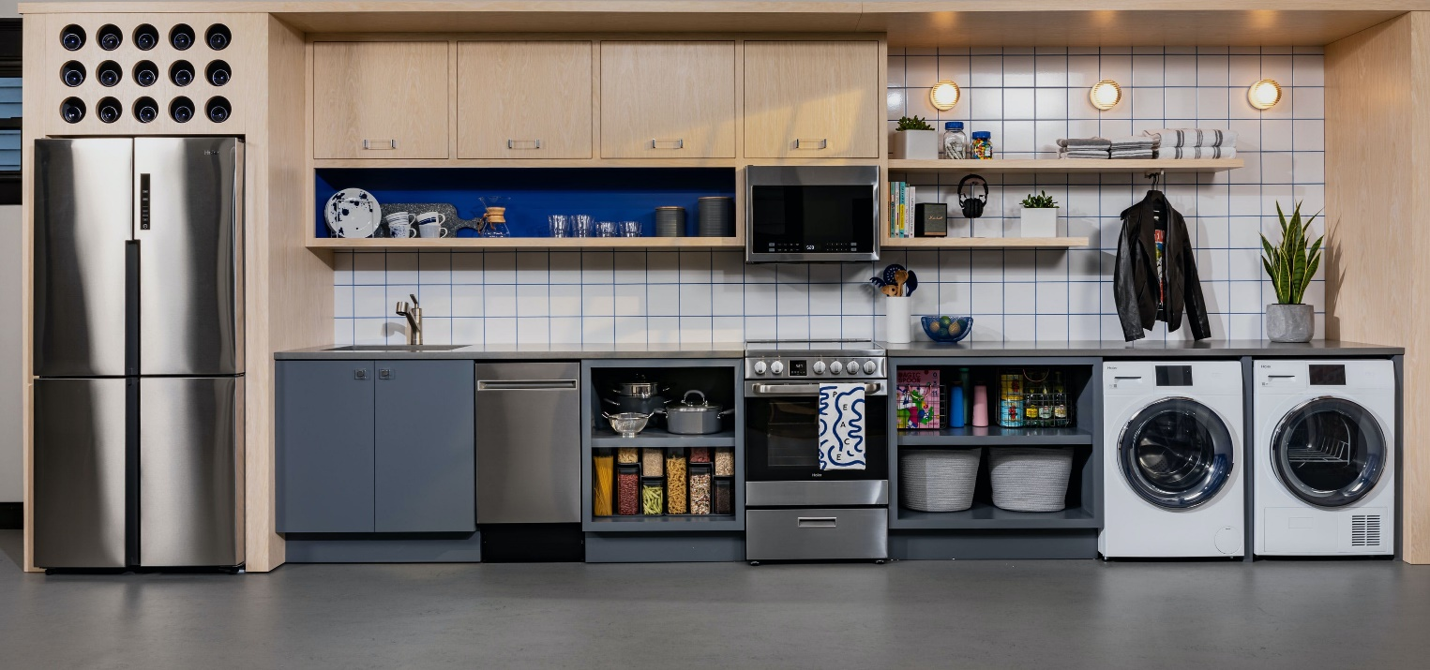
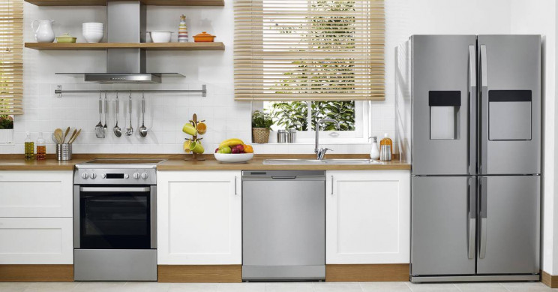
Build sentences
Examples:
Both kitchens are too big.
The fridge in image A is like the fridge in image B.
A B

